Slide 1


UNIVERSITY INSTITUTE OF ENGINEERING
COMPUTER SCIENCE ENGINEERING
Bachelor of Engineering (Computer Science & Engineering)
Subject Name: STATISTICAL METHODS USING R
Subject Code: 20SMT-460

Slide 2
Applications of R Programming

Slide 3
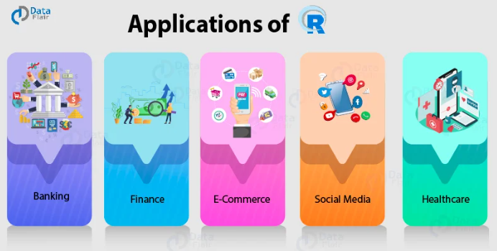

Slide 4
1. Finance
Data Science is most widely used in the financial industry.
R is the most popular tool for this role. This is because R provides an advanced statistical suite that is able to carry out all the necessary financial tasks.
With the help of R, financial institutions are able to perform downside risk measurement, adjust risk performance and utilize visualizations like candlestick charts, density plots, drawdown plots, etc.

Slide 5
R also provides tools for moving averages, autoregression and time-series analysis which forms the crux of financial applications. R is being widely used for credit risk analysis at firms like ANZ and portfolio management.
Finance industries are also leveraging the time-series statistical processes of R, to model the movement of their stock-market and predict the prices of shares. R also provides facilities for financial data mining through its packages like quantmod, pdfetch, TFX, pwt, etc. R makes it easy for you to extract data from online assets. With the help of RShiny, you can also demonstrate your financial products through vivid and engaging visualizations.

Slide 6
2. Banking
Just like financial institutions, banking industries make use of R for credit risk modeling and other forms of risk analytics.
Banks make heavy usage of the Mortgage Haircut Model that allows them to take over the property in case of loan defaults. Mortgage Haircut Modelling involves sales price distribution, the volatility of the sales price and the calculation of expected shortfall. For these purposes, R is often used alongside proprietary tools like SAS.

Slide 7
R is also used in conjunction with Hadoop to facilitate the analysis of customer quality, customer segmentation, and retention.
Bank of America makes use of R for financial reporting. With the help of R, the data scientists at BOA are able to analyze financial losses and make use of R’s visualization tools.

Slide 8
3. Healthcare
Genetics, Bioinformatics, Drug Discovery, Epidemiology are some of the fields in healthcare that make heavy usage of R. With the help of R, these companies are able to crunch data and process information, providing an essential backdrop for further analysis and data processing.
For more advanced processing like drug discovery, R is most widely used for performing pre-clinical trials and analyzing the drug-safety data. It also provides a suite for performing exploratory data analysis and vivid visualization tools to its users.
R is also popular for its Bioconductor package that provides various functionalities for analyzing the genomic data. R is also used for statistical modeling in the field of epidemiology, where data scientists analyze and predict the spread of diseases.

Slide 9
4. Social Media
For many beginners in Data Science and R, social media is a data playground. Sentiment Analysis and other forms of social media data mining are some of the important statistical tools that are used with R.
Social Media is also a challenging field for Data Science because the data prevalent on social media websites is mostly unstructured in nature. R is used for social media analytics, for segmenting potential customers and targeting them for selling your products.

Slide 10
5. E-Commerce
The e-commerce industry is one of the most important sectors that utilize Data Science. R is one of the standard tools that is being used in e-commerce.
Since these internet-based companies have to deal with various forms of data, structured and unstructured, as well as from varying data sources like spreadsheets and databases (SQL & NoSQL), R proves to be an effective choice for these industries.
E-commerce companies use R for analyzing cross-selling products to their customers. In cross-selling, we suggest additional products to the customer, that complements their original purchase. These types of suggestions and recommendations are best analyzed with the help of R.

Slide 11
6. Manufacturing
Manufacturing companies like Ford, Modelez, and John Deere use R to analyze customer sentiment. This helps them optimize their product according to trending consumer interests and also to match their production volume to varying market demand. They also use R to minimize their production costs and maximize profits.

Slide 12
Real-Life Use Cases of R Language
R applications are not enough until you don’t know how people/companies are using the R programming language.
Facebook – Facebook uses R to update status and its social network graph. It is also used for predicting colleague interactions with R.
Ford Motor Company – Ford relies on Hadoop. It also relies on R for statistical analysis as well as carrying out data-driven support for decision making.
Google – Google uses R to calculate ROI on advertising campaigns and to predict economic activity and also to improve the efficiency of online advertising.

Slide 13
Foursquare – R is an important stack behind Foursquare’s famed recommendation engine.
John Deere – Statisticians at John Deere use R for time series modeling and also geospatial analysis in a reliable and reproducible way. The results are then integrated with Excel and SAP.
Microsoft – Microsoft uses R for the Xbox matchmaking service and also as a statistical engine within the Azure ML framework.
Mozilla – It is the foundation behind the Firefox web browser and uses R to visualize web activity.
New York Times – R is used in the news cycle at The New York Times to crunch data and prepare graphics before they go for printing.

Slide 14
Thomas Cook – Thomas Cook uses R for prediction and also Fuzzy Logic Systems to automate price settings of their last-minute offers.
National Weather Service – The National Weather Service uses R at its River Forecast Centers. Thus, it is used to generate graphics for flood forecasting.
Twitter – R is part of Twitter’s Data Science toolbox for sophisticated statistical modeling.
Trulia – Trulia, the real-estate analysis website uses R for predicting house prices and local crime rates.
ANZ Bank – ANZ, the fourth largest bank in Australia uses R for its credit risk analysis.

